Slide 1
Motor controller
Jake Neal
Cameron Shea
Notes:
Cameron

Slide 2
Play By PLay
Keypad
Pulse Width Modulation & Stopwatch
Circuitry
Control System
Conclusions
Notes:
Cameron
Mention the “division” between “circuitry” and “control system”

Slide 3
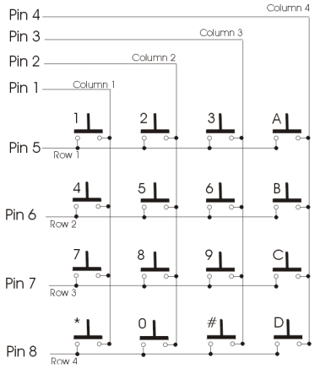
Keypad
Velleman 16-Key Matrix
Operation
8 Output Lines
16 Possibilities
How do we know which key was pressed?
http://www.eng.auburn.edu/~nelson/courses/elec3040_3050
Notes:
Explain the operation
-pushing button closes the circuit
-pull up resistors provide voltage difference to “see” on the output

Slide 4
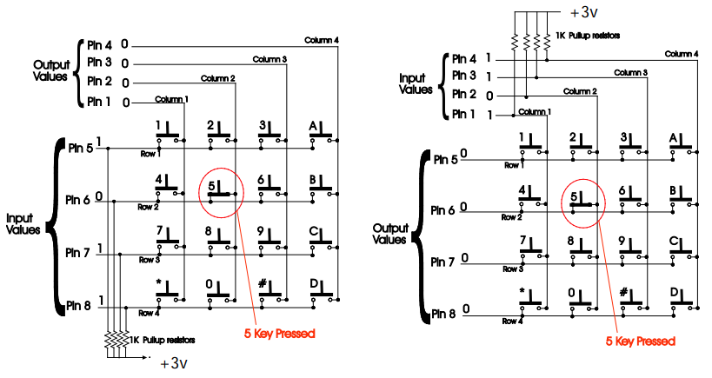


Keypad (cont.)
Standard Scan Algorithm
Scans all 8 pins when pressed
Risky Business (Cue Tom Cruise…)
Alternate
Read the column and then row
This way is the…
http://www.eng.auburn.edu/~nelson/courses/elec3040_3050
Tom Cruise Image: www.gstatic.com
Safeway Logo: vignette.wikia.nocookie.net/logopedia
Notes:
Algorithm
-column by column until found
-row by row until found
Alternate
-read all rows
-read all columns
-LOGIC!
-If else if
-x row && y column → __ key
Sidenote
-long drawn out code is a common theme with us…BUT IT WORKED!

Slide 5
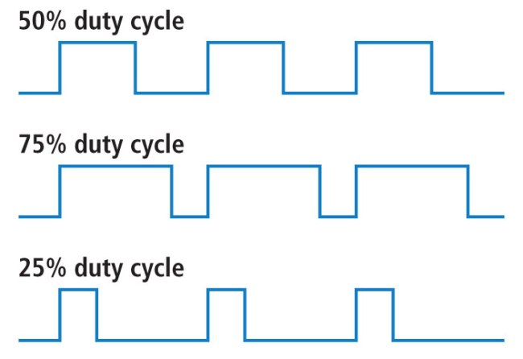

Pulse Width Modulation & stopwatch
Both controlled by timers
Basics of PWM
Duty Cycle
Period
Stopwatch
Timer 11 already sampled every 10 ms…and we needed 100ms…math
https://cdn.sparkfun.com
Beautiful Mind: i.guim.co.uk
Notes:
Timers
-10 for the PWM
-11 for the stopwatch and control system (spoiler alert)

Slide 6
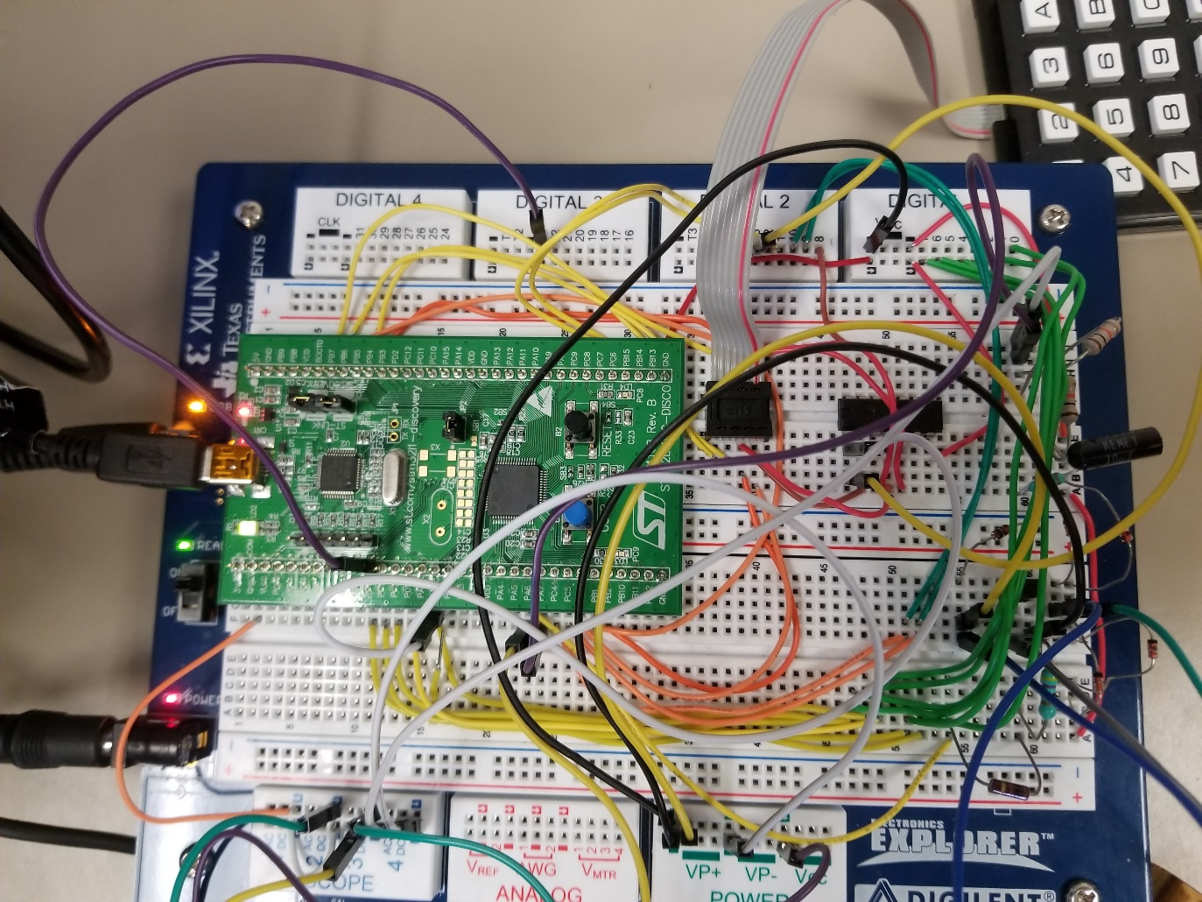
Circuitry
Boards
Noteworthy Circuitry
LEDs
Keypad
AND gate chip
“Fires”
Tau and voltage divider
Notes:
Fires: Amplifier and Rectifier
Voltage divider: 12V→?V

